Slide 1
Incorporating Anti-Corruption Education into the Christian Higher Education Context
Robert Osburn
June 2, 2016
IAPCHE Conference (South Korea)

Slide 2
Definition of Corruption
The social and personal decay that results when people seek their private gain at public expense

Slide 3
US$ One trillion in bribes each year

Slide 4
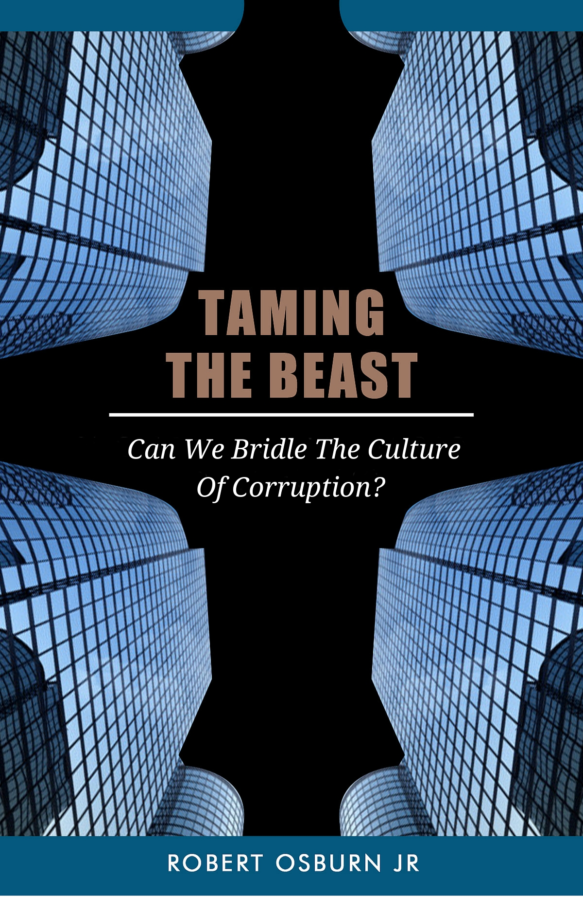
2016

Slide 5
4 Streams, 1 Mighty Torrent
Primordial Sin
Premodern Shamanism
Modern State
Postmodern Suspicion

Slide 6
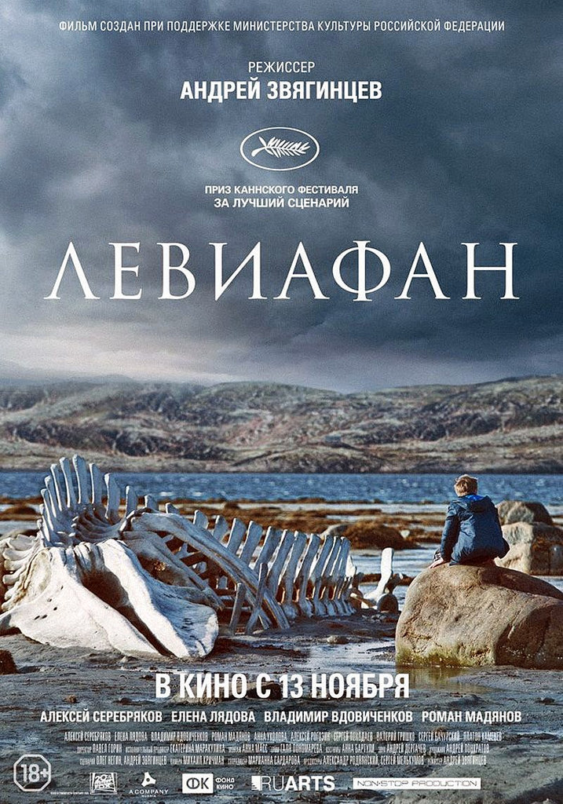
Leviathan (2014)
https://www.flickr.com/photos/wolfgangkuhnle/17333652961

Slide 7
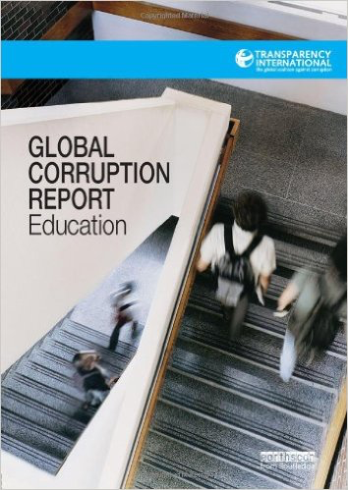
Sweeney, Despota, and Lindner (2013)

Slide 8
Why should Christian higher educators develop an anti-corruption curriculum? (I)
Growing problem (anecdotally)
The growing edge of Christian higher education is increasingly in corrupt contexts
Christian worldview applies to practical as well as theoretical challenges
Christian faith offers redemptive resources that will be competitive in pluralistic world where Islam and neo-Confucianism are active

Slide 9
Why should Christian higher educators develop an anti-corruption curriculum? (II)
Enhance credibility of Christian higher education in an educational universe dominated by secularists
Among global faiths, Christianity is unique in its focus on corruption (80 biblical references)
Up to this point, absent from most Christian ethics textbooks, etc. (Osburn, 2011)
Corruption in Christian higher education

Slide 10
Biblical and Theological Foundations
God cannot be bribed (Deuteronomy 10:17)

Slide 11
Biblical and Theological Foundations
God cannot be bribed (Deuteronomy 10:17)
Corruption is inherently destructive (meaning of Hebrew and Greek words translated “corrupt”)

Slide 12
Biblical and Theological Foundations
God cannot be bribed (Deuteronomy 10:17)
Corruption is inherently destructive (meaning of Hebrew and Greek words translated “corrupt”)
Sinfulness corrupts (II Peter 1:4; Genesis 6:11; Puritan writers)

Slide 13
Biblical and Theological Foundations
God cannot be bribed (Deuteronomy 10:17)
Corruption is inherently destructive (meaning of Hebrew and Greek words translated “corrupt”)
Sinfulness corrupts (II Peter 1:4; Genesis 6:11; Puritan writers)
Jesus redeems His people from corrupt ways of life (II Peter 1:3-7)

Slide 14
Biblical and Theological Foundations
God cannot be bribed (Deuteronomy 10:17)
Corruption is inherently destructive (meaning of Hebrew and Greek words translated “corrupt”)
Sinfulness corrupts (II Peter 1:4; Genesis 6:11; Puritan writers)
Jesus redeems His people from corrupt ways of life (II Peter 1:3-7)
Christians are to “seek the welfare of the city” (Jeremiah 29:7)

Slide 15
Biblical and Theological Foundations
God cannot be bribed (Deuteronomy 10:17)
Corruption is inherently destructive (meaning of Hebrew and Greek words translated “corrupt”)
Sinfulness corrupts (II Peter 1:4; Genesis 6:11; Puritan writers)
Jesus redeems His people from corrupt ways of life (II Peter 1:3-7)
Christians are to “seek the welfare of the city” (Jeremiah 29:7)
The church of Jesus Christ is tasked with demonstrating God’s superior wisdom (Ephesians 3:10)

Slide 16
Existing Programs in Anti-Corruption Studies (I)
Certificates and Degrees:
International Anti-Corruption Academy: Two year Masters
University of Hong Kong: Postgraduate Certificate in Corruption Studies (30 credits)
University of Sussex: Masters in Corruption and Governance (one or two years)
International Centre for Parliamentary Studies: Professional Certificate in Anti-Corruption (5 days)

Slide 17
Existing Programs in Anti-Corruption Studies (II)
Coursework:
University of Portsmouth, Australian National University, George Washington University, Colgate University, Columbia University, New York University, and several others
Centers:
Centre of Anti-Corruption Studies (Hong Kong)
Specialization as part of Religion and Development Programme, University of Birmingham
Scholars of religion and corruption: Dr. Heather Marquette (University of Birmingham), Dr. Rachel McCleary (Harvard University)

Slide 18
Christian Anti-Corruption Education
Curricula
Student Life
Institutional confession

Slide 19
Curricula
Proposed: Inter-Disciplinary 15-credit undergraduate Certificate in Anti-Corruption Studies
Possible courses
Politics of corruption
Economics of corruption
Theology of corruption
Organizing and Instructing to fight corruption
Field project in anti-corruption studies

Slide 20
Student Life
Student clubs for combating corruption
Student essay competitions
Student project design competitions
Watch films about corruption (e.g., 2014 film about Russian corruption Leviathan)
Websites and social media anti-corruption campaign led by students

Slide 21
Institutional Confession
Alleman and Glanzer (2013)
Smith, J.K.A. (2009)
Ritual confession
Situational confession

Slide 22
What institution will take the challenge?
Christians can help define this nascent field while also helping to create leaders who will advocate against corruption
(God’s) intent was that now, through the church, the manifold wisdom of God should be made known to the rulers and authorities in the heavenly realms
(Ephesians 3:10)

